Slide 1
WEBMONK (COURSE DAY - 15)
Topics covered:
* what is react routing
* react routing with lazy loading using suspense

Slide 2
REACT ROUTING

Slide 3
REACT ROUTING
* installation:
npm install react-router-dom or yarn add react-router-dom
* types:
BrowserRouter -- https://application.com/dashboard
HashRouter -- https://application.com/#/dashboard
* BrowserRouter uses the newer History API.
* Components:
* BrowserRouter, usually aliased as Router: wraps all your Route components.
* Link: used to generate links to your routes
Route: responsible for showing - or hiding - the components they contain.

Slide 4
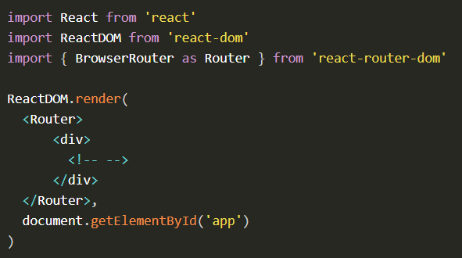
BROWSER ROUTER
A BrowserRouter component can only have one child element, so we wrap all we’re going to add in a div element.

Slide 5
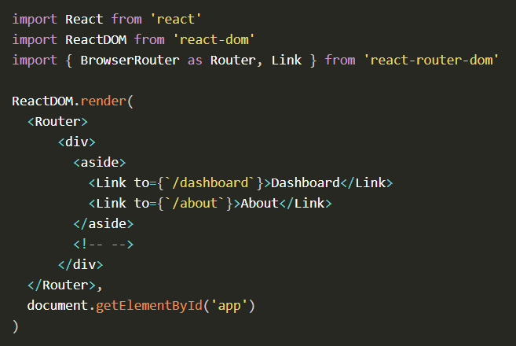
LINK
The Link component is used to trigger new routes. You import it from react-router-dom, and you can add the Link components to point at different routes, with the to attribute:

Slide 6
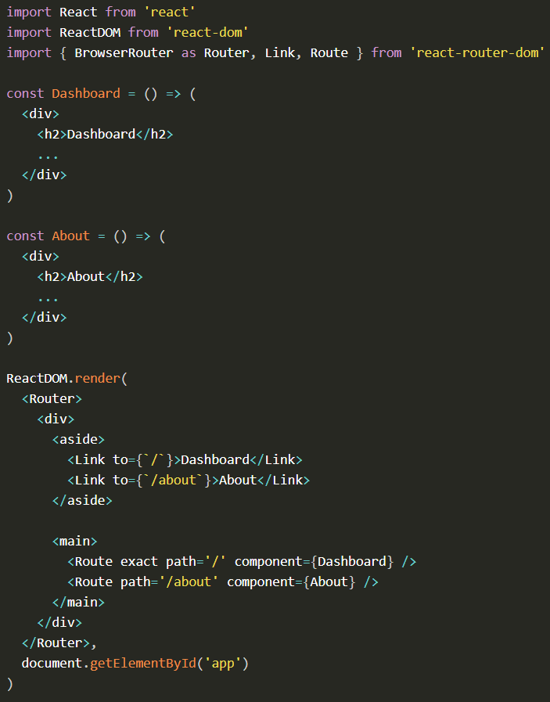
LINK
In here, When the route matches /, the application shows the Dashboard component.
When the route is changed by clicking the “About” link to /about, the Dashboard component is removed and the About component is inserted in the DOM.
Notice the exact attribute. Without this, path="/" would also match /about, since / is contained in the route.

Slide 7
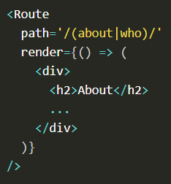
INLINE RENDERING
Instead of specifying a component property on Route, you can set a render prop:

Slide 8
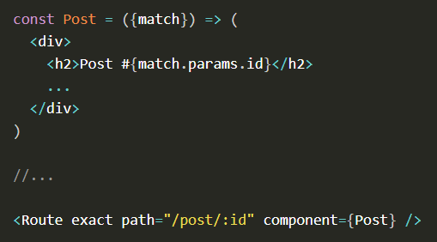
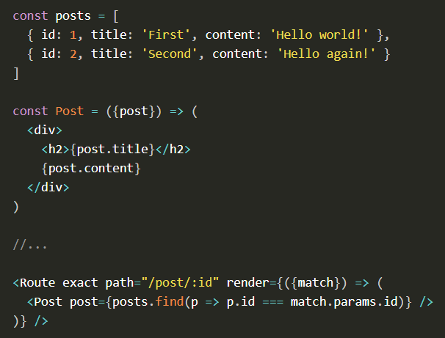
MATCH DYNAMIC ROUTE PARAMETER
In your Route component you can lookup the dynamic parameters in match.params.
match is also available in inline rendered routes, and this is especially useful in this case, because we can use the id parameter to lookup the post data in our data source before rendering Post:

Slide 9
LAZY LOADING WITH SUSPENSE

Slide 10
LAZY LOADING WITH SUSPENSE
* React.Suspense, along with React.lazy(), introduced in v16.6, adds new functionality that allows components to wait for something before actually rendering. This new ability makes code splitting and lazy loading of React components a breeze!
* import:
import React, { lazy, Suspense } from 'react';
* React.lazy(): The lazy() method takes a function as the first parameter which is expected to import another component, like so:
const SomeComponent = lazy(() => import('./SomeComponent');
Because the import is inside of a function passed to lazy(), the loading of the component won’t happen until we actually use the component, instead of being eagerly loaded with the other imports at the top of your file.

